Slide 1
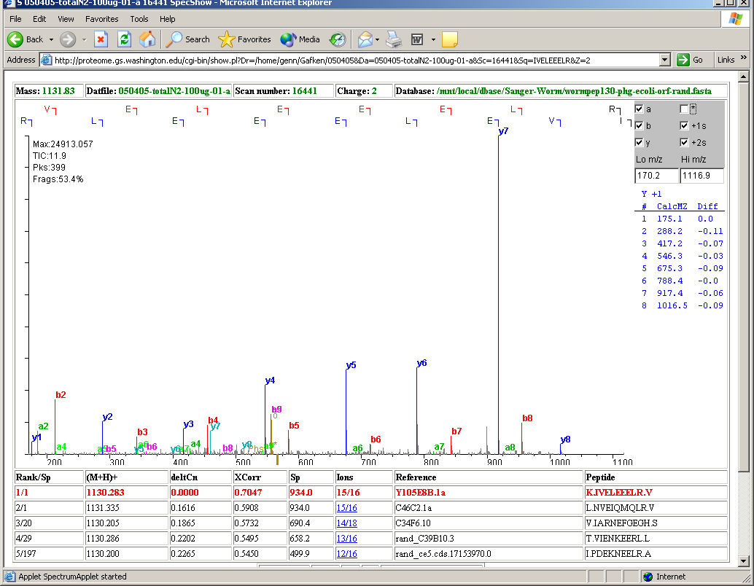

Slide 2
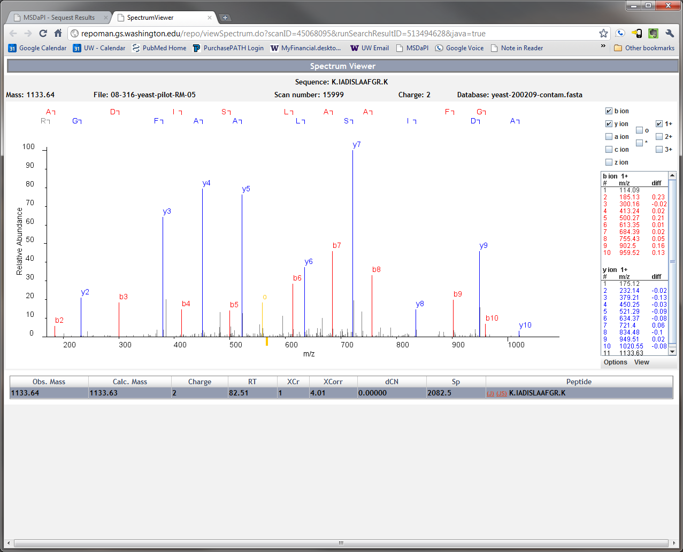
YER043C

Slide 3
Single Cell and Spatial Proteomics

Slide 4
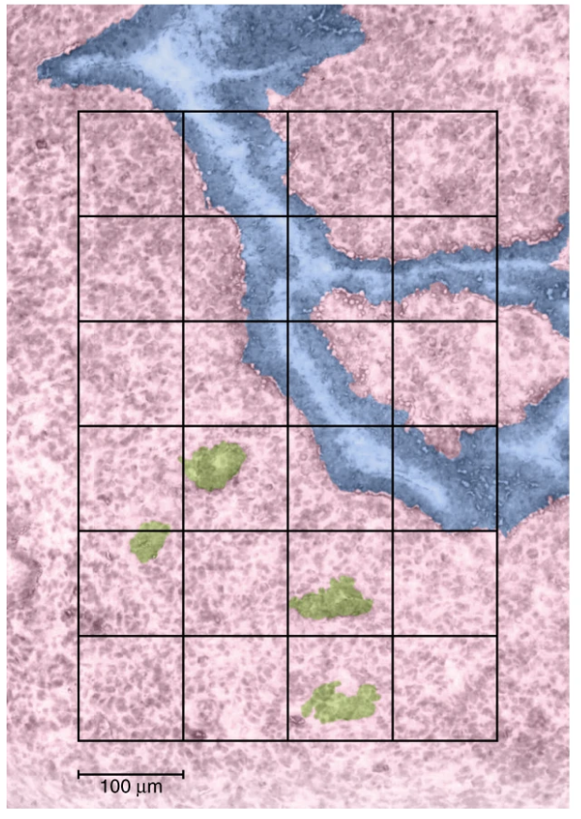
Problems with spatial and single cell proteomics?
We can’t amplify proteins.
As you increase the spatial resolution you decrease the amount of protein.
Increased spatial resolution requires more runs
Proteins are sticky … you lose a portion of protein to every surface they touch.
Proteomics experiments are slow.

Slide 5
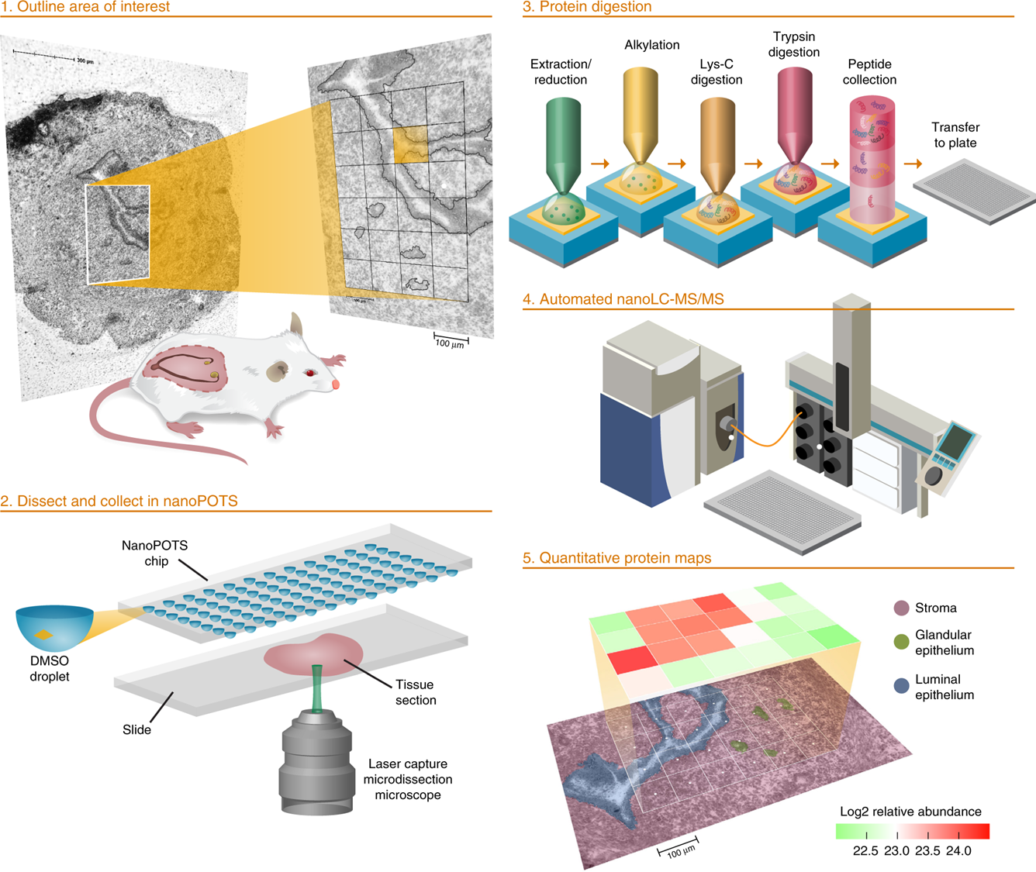
Piehowski et al Nature Communications 2020

Slide 6
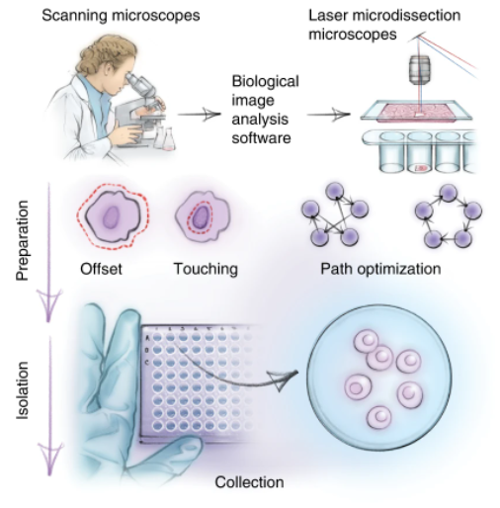
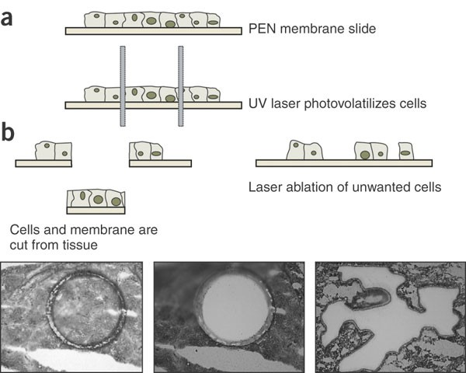
Emmert-Buck et al Science 1996

Slide 7
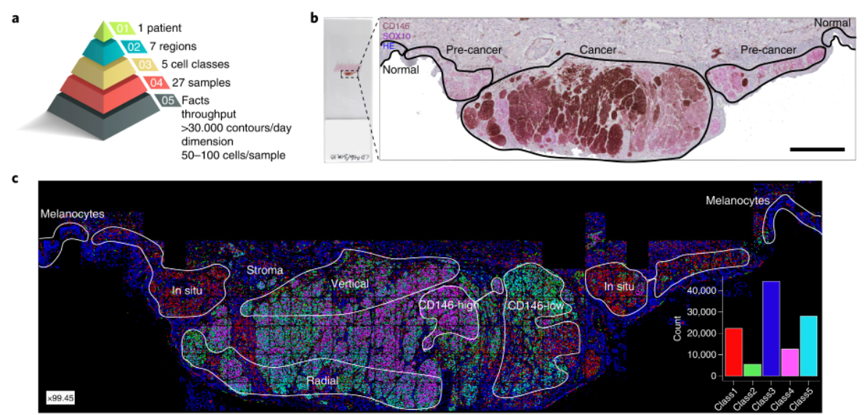
Mund et al Nature Biotech 2022

Slide 8
Some statistics
3 million protein molecules per 1 µm³
yeast 30 µm³ = 100 million molecules
HeLa 3000 µm³ (~15 µm diameter) = 10 billion molecules … approx. 700 picograms
Many people focus on ~10-100 cell regions (7-70 ng)

Slide 9
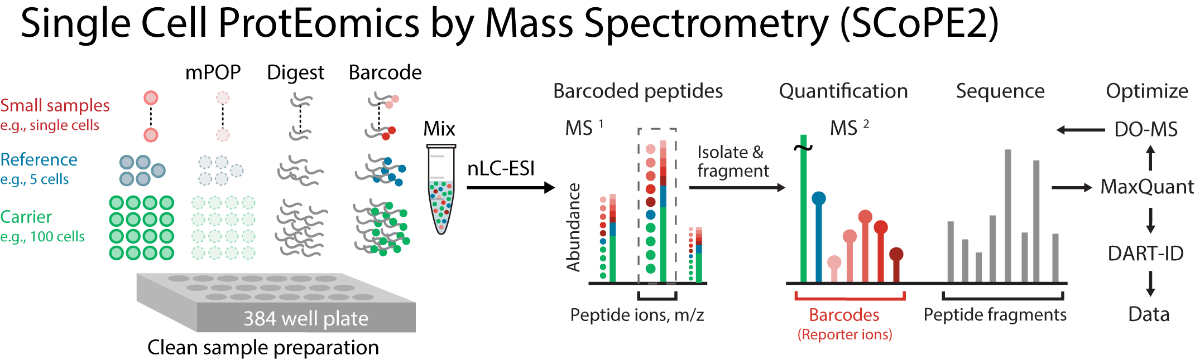

Slide 10
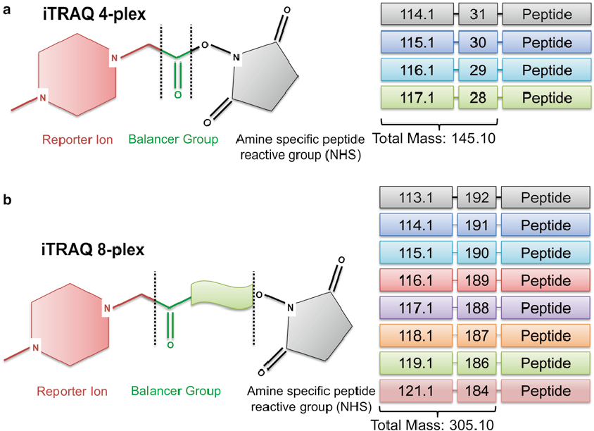
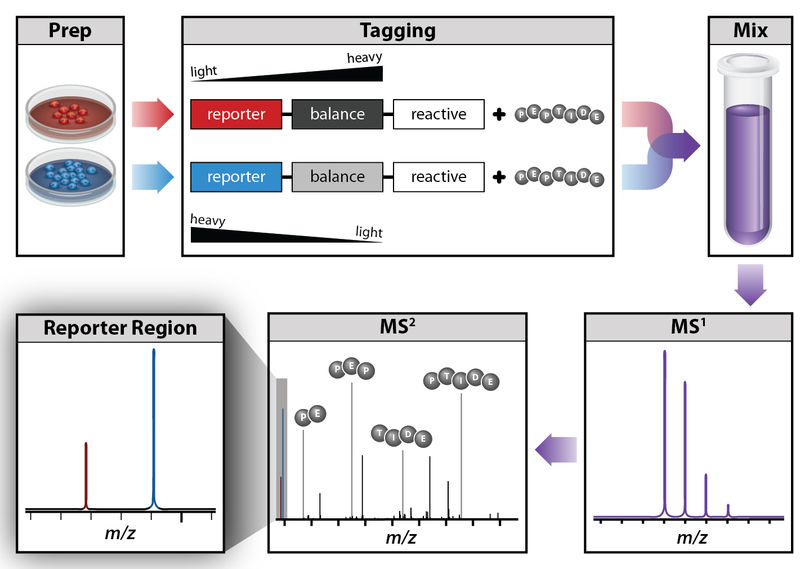
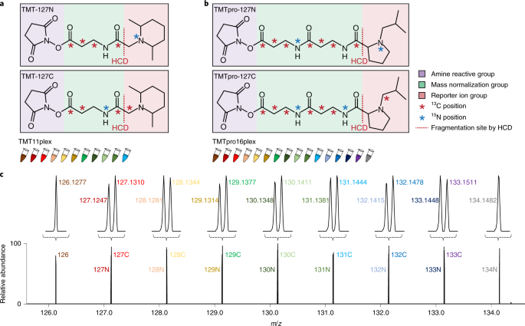
Review: Tandem Mass Tags (TMT)

Slide 11
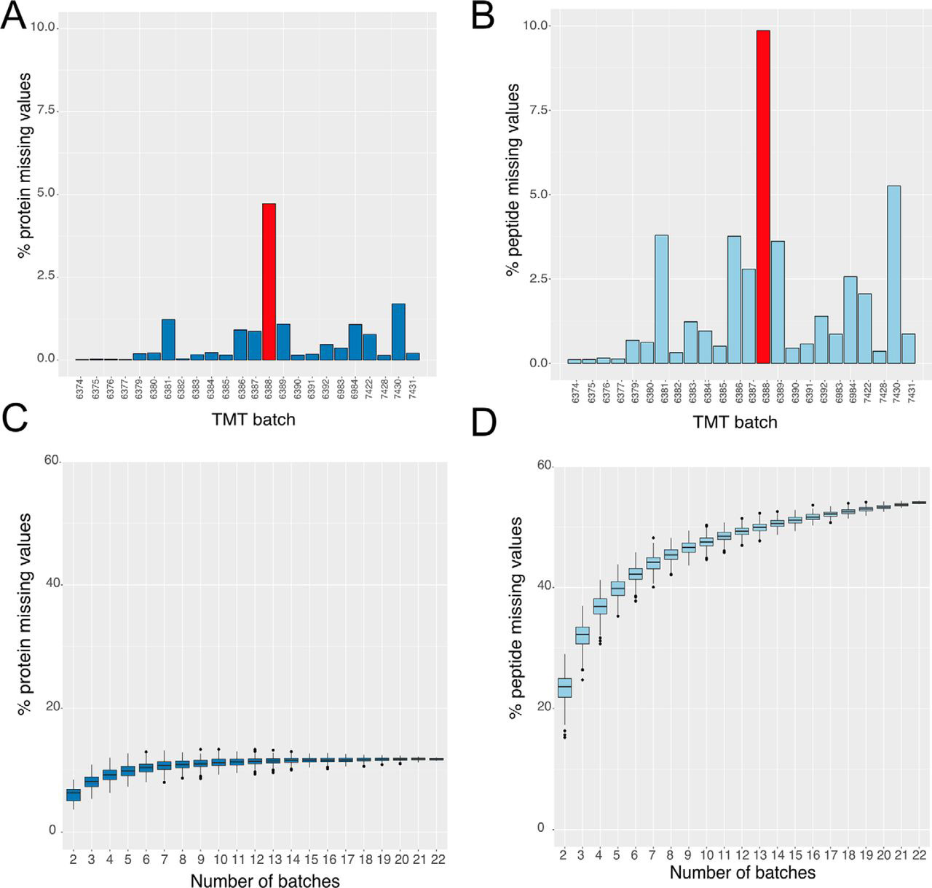
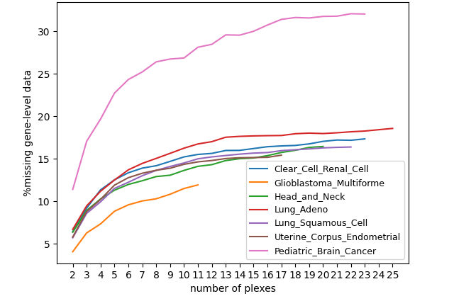
Struggle with Missing Values Between Batches
CPTAC Data
Brenes et al MCP 2019

Slide 12
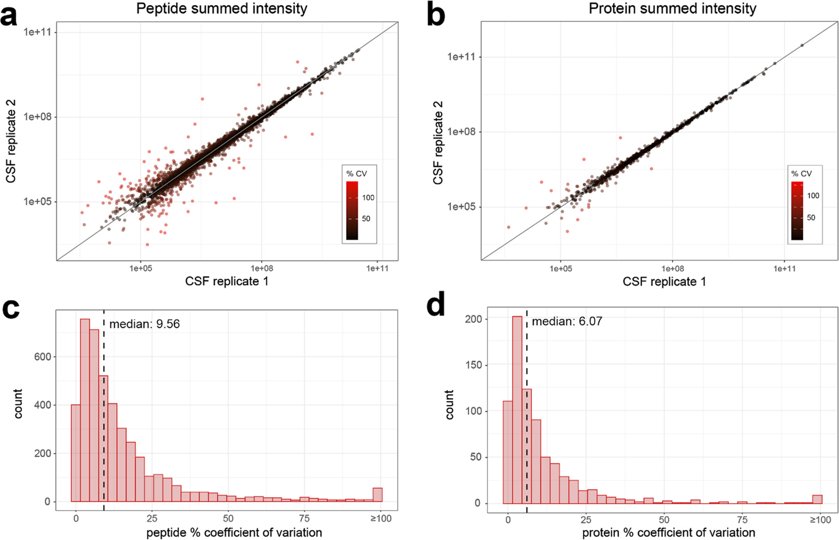

Slide 13
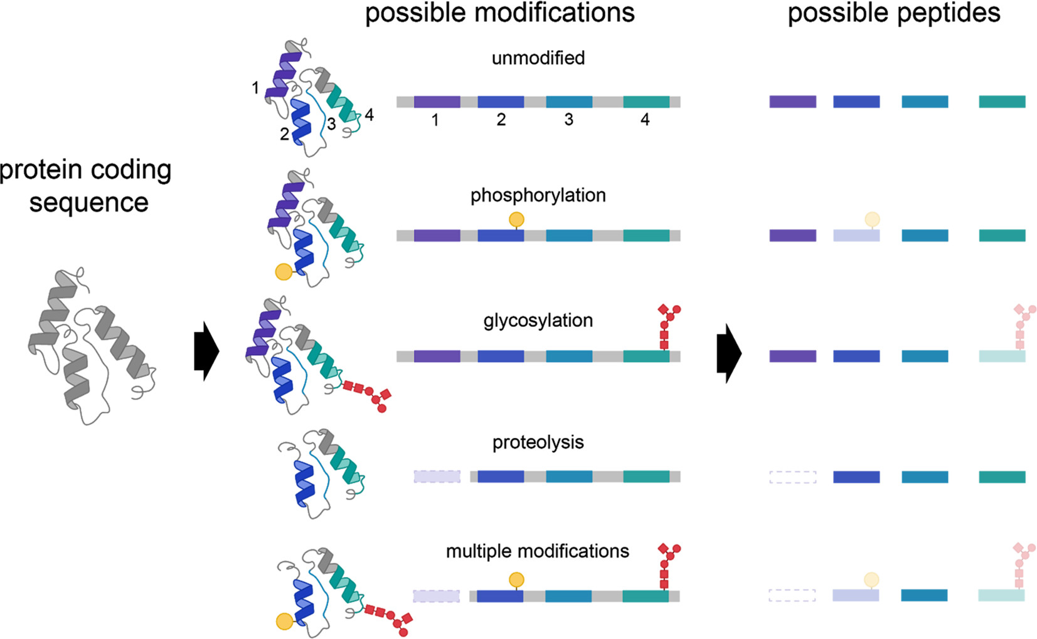

Slide 14
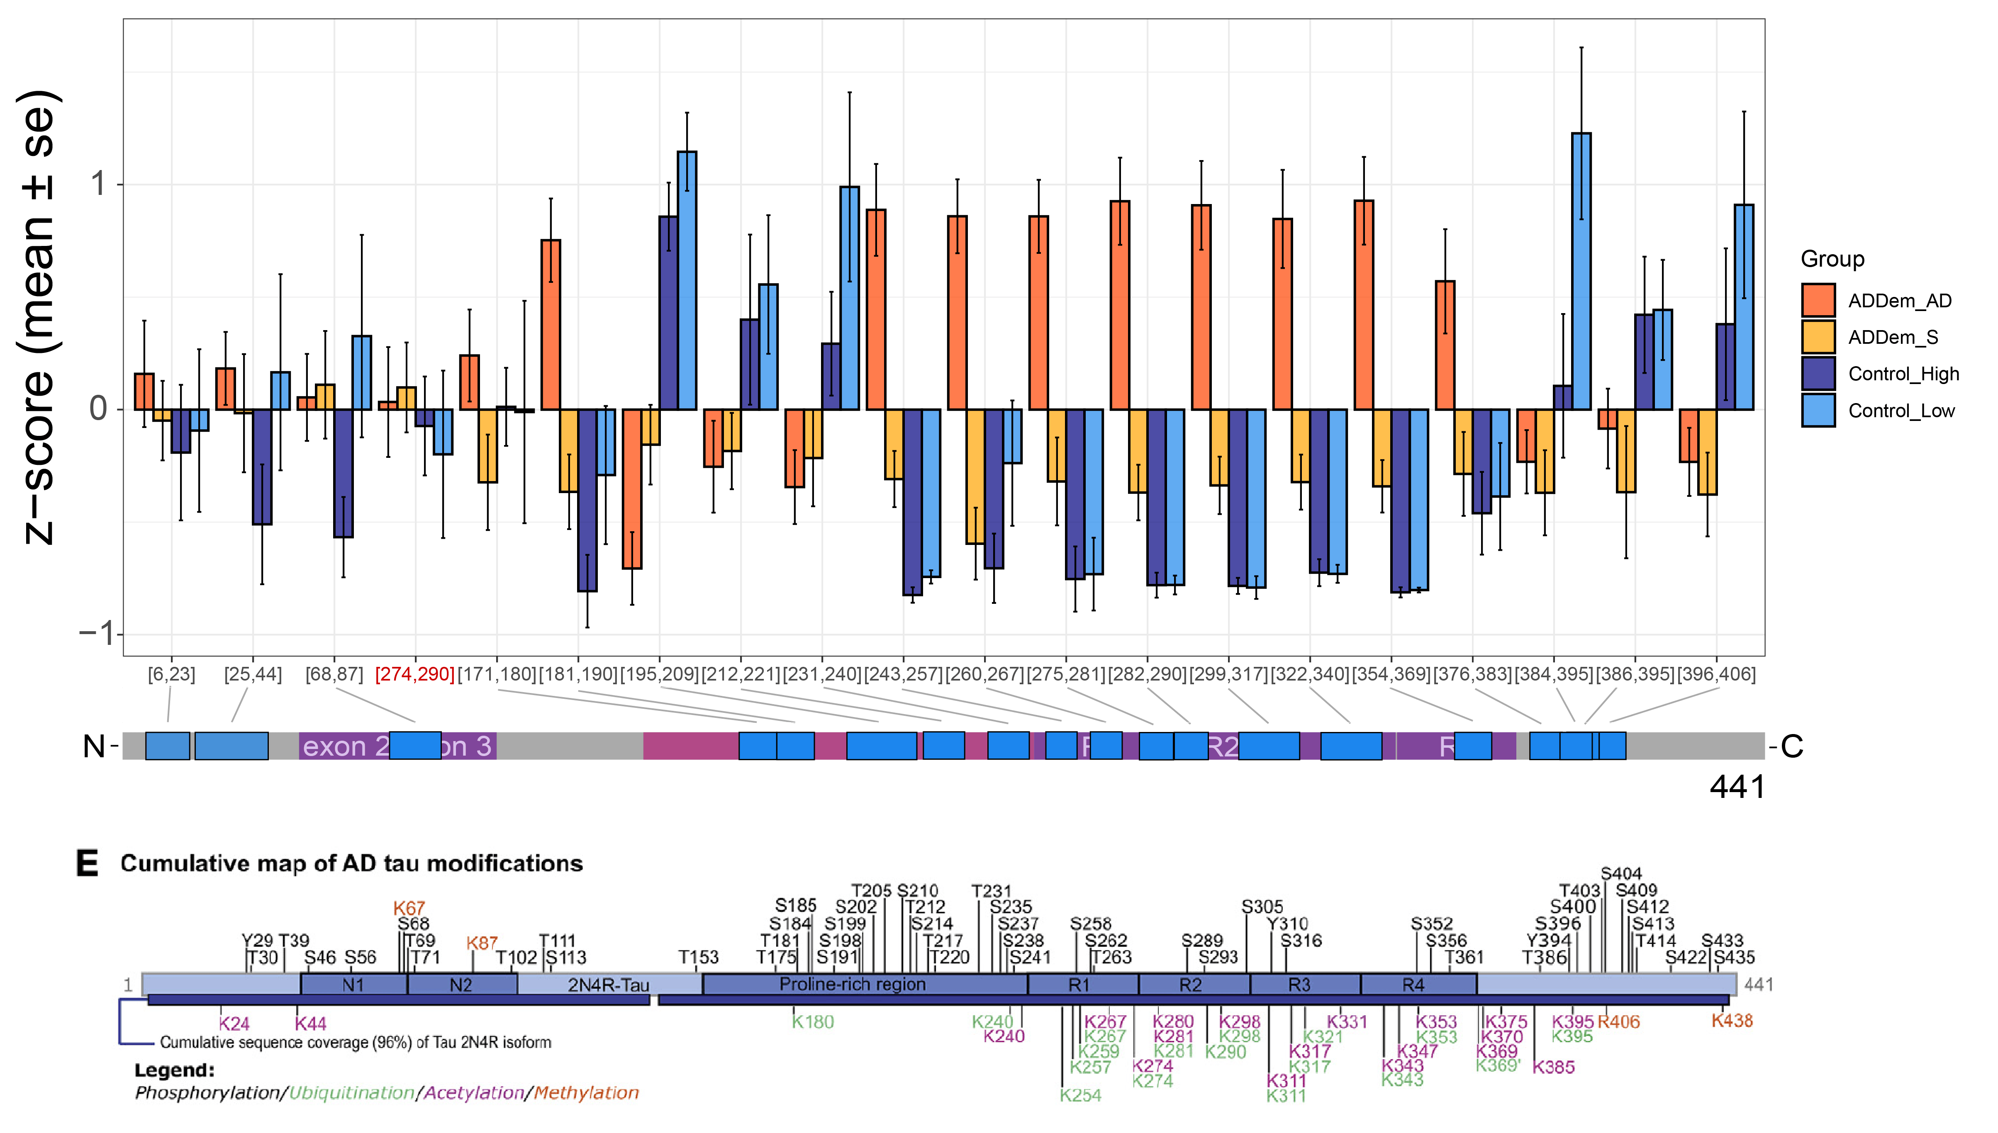
Tau has peptide abundance profiles that differ by domain
Adapted Wesseling et a., Cell 2020
Notes:
Exon 4a – PNS-Tau … Tau that circulates in peripheral nervous system

Slide 15
Tau has peptide abundance profiles that differ by domain
Adapted Wesseling et a., Cell 2020
Notes:
Exon 4a – PNS-Tau … Tau that circulates in peripheral nervous system

Slide 16
Tau has peptide abundance profiles that differ by domain
Adapted Wesseling et a., Cell 2020
Notes:
Exon 4a – PNS-Tau … Tau that circulates in peripheral nervous system

Slide 17
Tau has peptide abundance profiles that differ by domain
Adapted Wesseling et al., Cell 2020
Notes:
Exon 4a – PNS-Tau … Tau that circulates in peripheral nervous system

Slide 18
Tau has peptide abundance profiles that differ by domain
Adapted Wesseling et al., Cell 2020
Notes:
Exon 4a – PNS-Tau … Tau that circulates in peripheral nervous system

Slide 19
Alternatives
Targeted proteomics
Con: Small number of preselected targets
Con: Multiplexing samples is hard
Pro: Very sensitive and minimally effected by the presence of a carrier
Pro: No missing data
Data Independent Acquisition
Pro: Doesn’t rely on seeing a precursor ion
Pro: No missing data
Pro: No targets need to be preselected
Con: Data analysis complex
Con: Not as sensitive as targeted
Con: Multiplexing hard
Con: Effected by presence of carrier

Slide 20
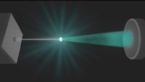
Flow Cytometry

Slide 21
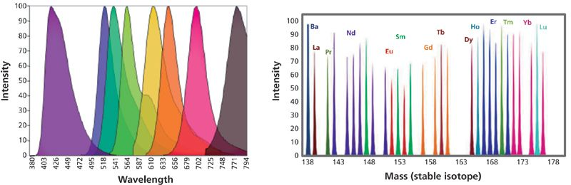
Multiplexing with Heavy Metals

Slide 22
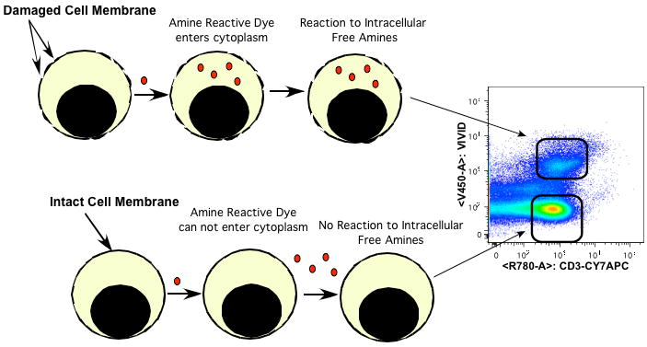
Staining for cell viability
Notes:
propidium iodide (PI), 7-aminoactinomycin D (7-AAD), and DRAQ7 are used to stain non-viable cells. Antibodies exhibit nonspecific binding in dead cells. Greater fluorescence due to increased content of accessible free amines allows dead cells to be easily distinguished from live cells.

Slide 23
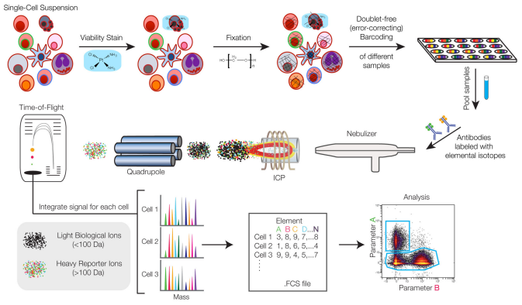
Mass Cytometry
Notes:
propidium iodide (PI), 7-aminoactinomycin D (7-AAD), and DRAQ7 are used to stain non-viable cells. Antibodies exhibit nonspecific binding in dead cells. Greater fluorescence due to increased content of accessible free amines allows dead cells to be easily distinguished from live cells.

Slide 24
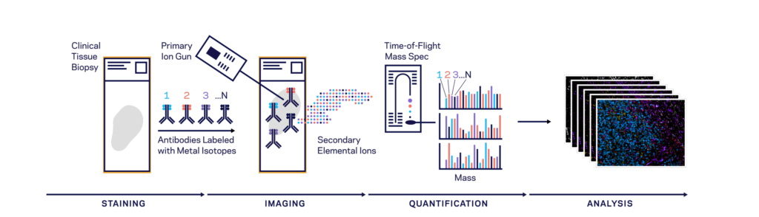
Multiplexed Ion Beam Imaging

Slide 25
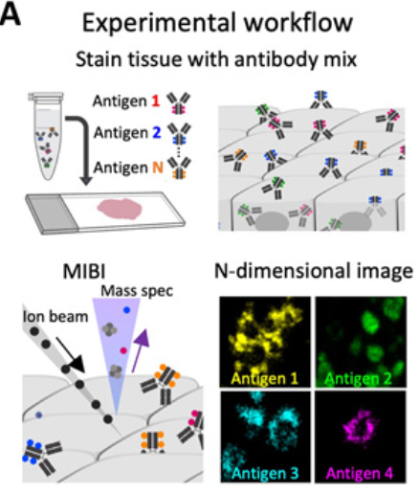

Slide 26
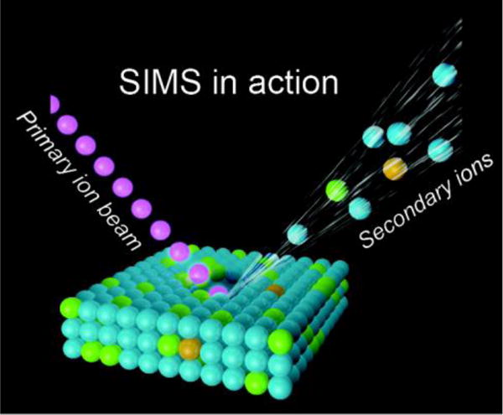
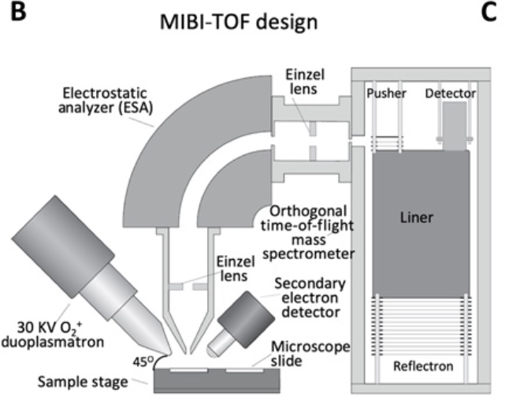

Slide 27
